Slide 1


Python^{3.7}

Slide 2

Agenda
Python Essentials- Day 2
01 | Getting started with Loops | 05 | Exercises
02 | List
03 | Tuples
04 | Dictionary

Slide 3

List
List is a collection which is ordered and changeable. Allows duplicate members.

Slide 4

Tuple
A tuple is a collection which is ordered and unchangeable. In Python tuples are written with round brackets.

Slide 5
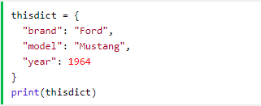
Dictionary
A dictionary is a collection which is unordered, changeable and indexed. In Python dictionaries are written with curly brackets, and they have keys and values.

Slide 6

Practical Lab
hisss…ss…
Lets Python!

Slide 7
Summary
Python Data Types
List
Tuple
Dictionary

